Slide 1


BRAND UNIFICATION FOR
IMPROVING AD TARGETING, ANALYTICS, AND USER EXPERIENCES

Slide 2

ABOUT

Slide 3


Business Problem Statement
Case Study Objectives
Criteo’s mission is to empower marketers with trusted and impactful advertising. However, inconsistent brand data creates inefficiencies in ad targeting and analytics, undermining this mission.
Our Solution
Dynamic Solutions for Brand Unification:
Clustering Algorithms
Fuzzy Matching
External APIs

Slide 4
THE PROBLEM: INCONSISTENT BRAND DATA
Increases Operational Costs
01
06
Reduces Ad Targeting Precision
02
Complicates Data Integration
INDUSTRY CHALLENGES
Impacts Analytics Reliability
05
Causes Campaign Misalignment
03
04
Undermines Advertising Impact

Slide 5

THE SOLUTION: UNIFYING BRAND NAMES
Similarity
Cleaning
Technical Approach
Scrapping and API

Slide 6
Cleaning
Loaded and normalized brand names.
Translated non-English names and replaced missing data.
Data Preparation
Normalization and Translation
Converted to lowercase, removed accents and special characters.
Korean names translated to English
Similarity/Fuzzy Matching
Applied Google category IDs and taxonomy codes
Mapped brands to structured subcategories (Levels 1-7)
Categorization
Metadata and Readiness
Retained essential metadata for analysis
Dataset standardized and ready for modelling
Technical Approach
Scrapping and API

Slide 7
Cleaning
Data Preparation
Loaded and normalized brand names.
Translated non-English names and replaced missing data.
Normalization and Translation
Converted to lowercase, removed accents and special characters.
Korean names translated to English
Similarity/Fuzzy Matching
Applied Google category IDs and taxonomy codes
Mapped brands to structured subcategories (Levels 1-7)
Categorization
Metadata and Readiness
Retained essential metadata for analysis
Dataset standardized and ready for modelling
Technical Approach
Scrapping and API

Slide 8
Cleaning
Data Preparation
Loaded and normalized brand names.
Translated non-English names and replaced missing data.
Normalization and Translation
Converted to lowercase, removed accents and special characters.
Korean names translated to English
Similarity/Fuzzy Matching
Applied Google category IDs and taxonomy codes
Mapped brands to structured subcategories (Levels 1-7)
Categorization
Metadata and Readiness
Retained essential metadata for analysis
Dataset standardized and ready for modelling
Technical Approach
Scrapping and API

Slide 9
Cleaning
Data Preparation
Loaded and normalized brand names.
Translated non-English names and replaced missing data.
Normalization and Translation
Converted to lowercase, removed accents and special characters.
Korean names translated to English
Similarity/Fuzzy Matching
Applied Google category IDs and taxonomy codes
Mapped brands to structured subcategories (Levels 1-7)
Categorization
Metadata and Readiness
Retained essential metadata for analysis
Dataset standardized and ready for modelling
Technical Approach
Scrapping and API

Slide 10
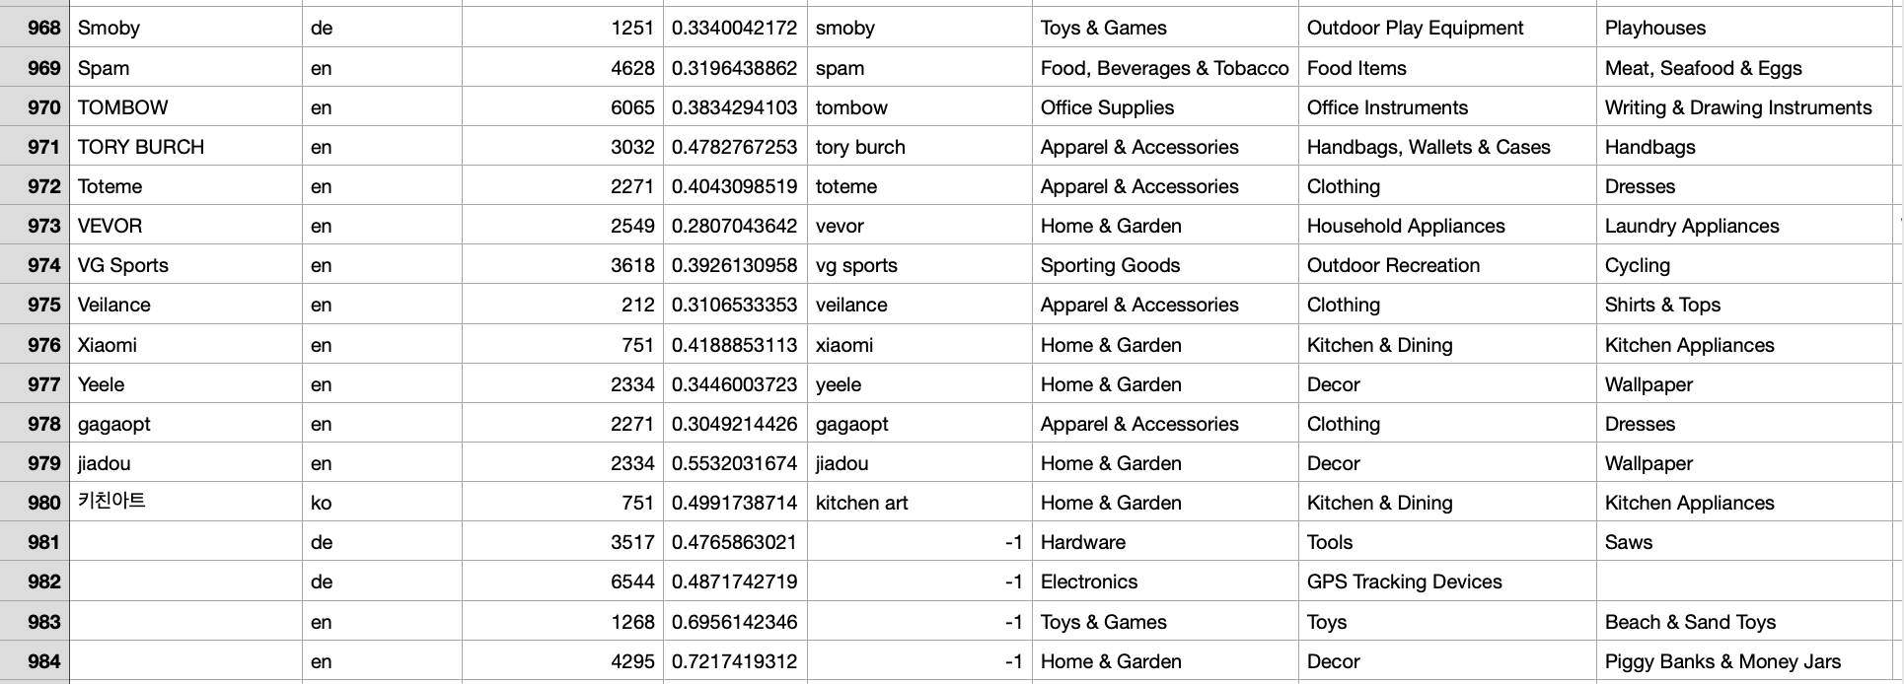
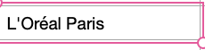
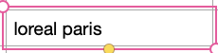
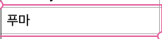
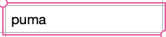
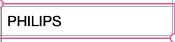
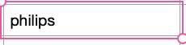
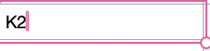
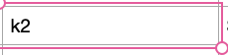
CLEANED DATA SAMPLE
Similarity/Fuzzy Matching
Technical Approach
Scrapping and API

Slide 11
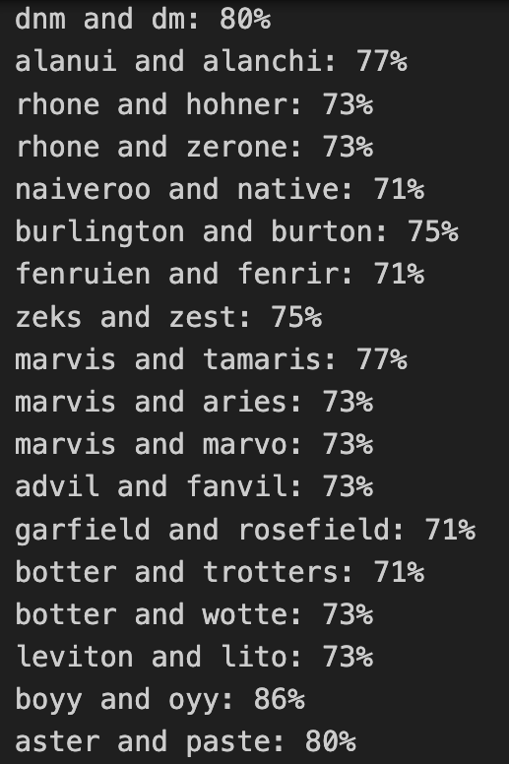
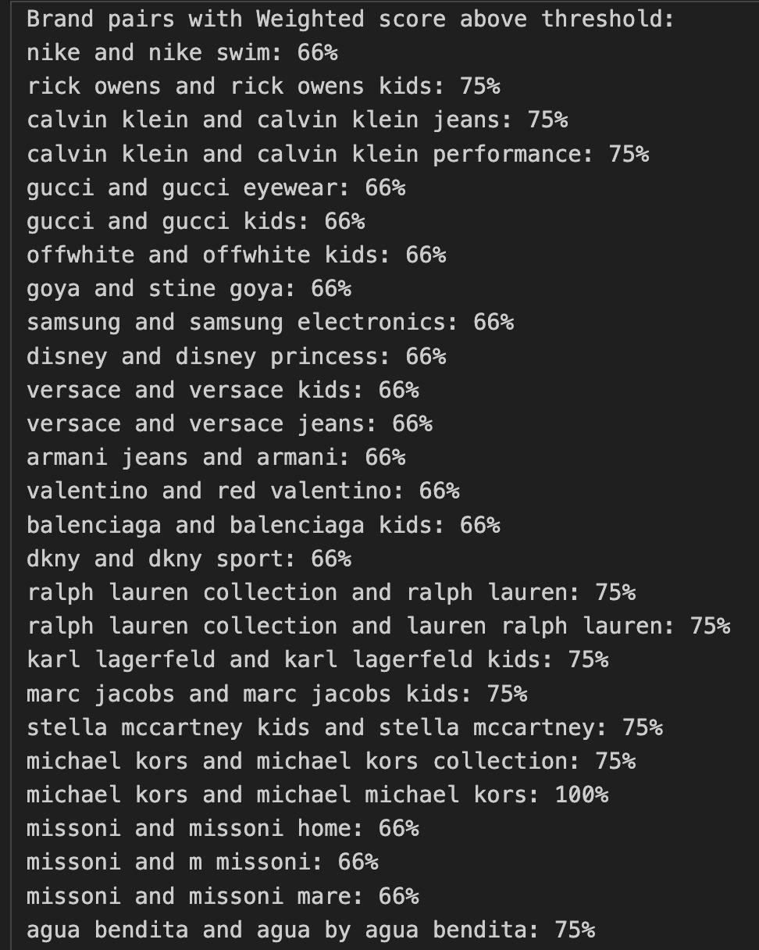
Similarity Calculation
Cleaning
Overview of Brand Similarity Metrics
Introduction to fuzzy and Jaccard similarity metrics.
Emphasis on identifying small typographical and formatting differences.
Technical Approach
Overview of brand pairs and their similarity scores highlighting the effectiveness of weighted metrics.
Scrapping and API

Slide 12
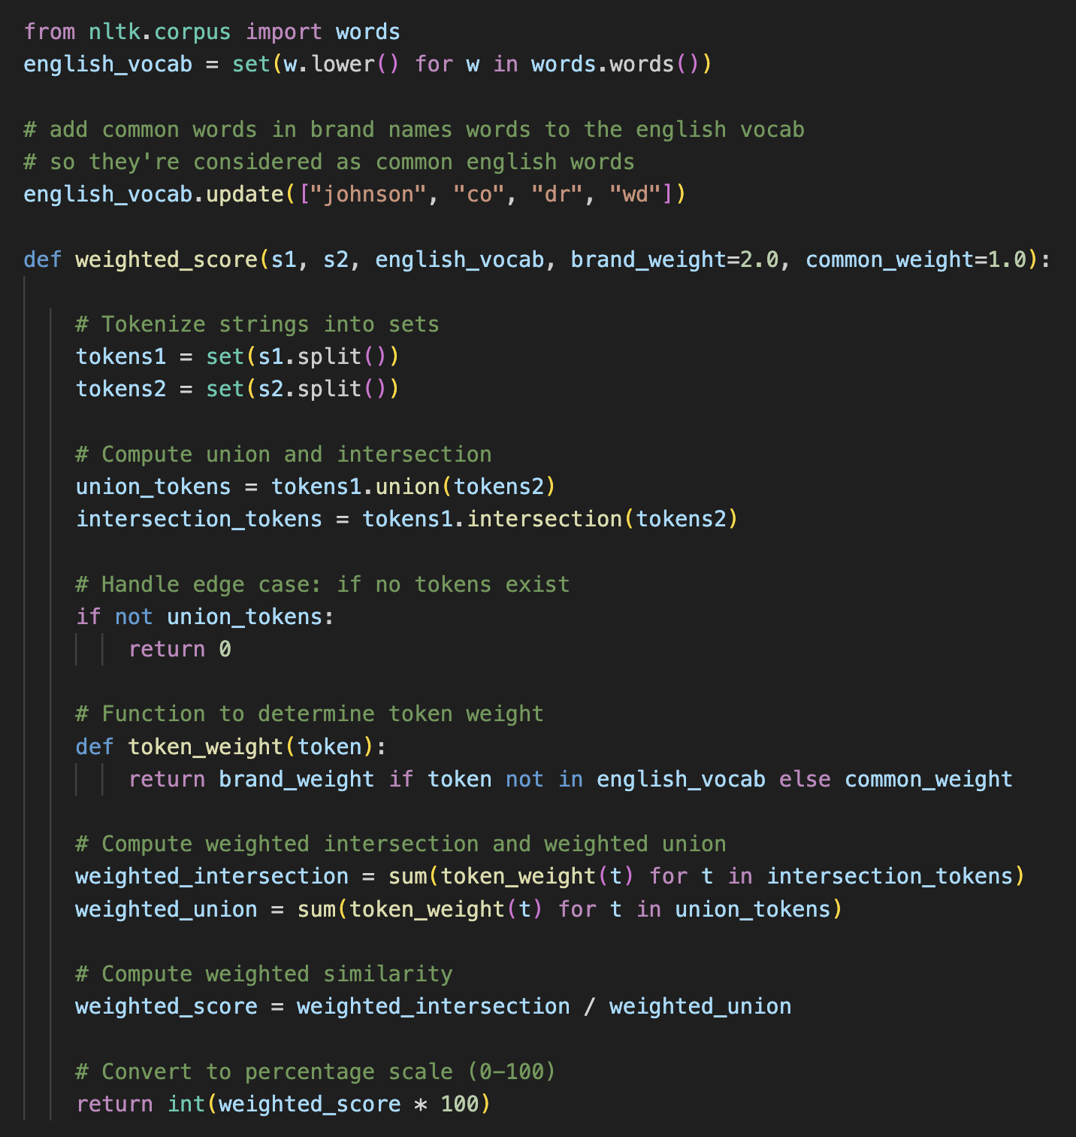
Similarity Calculation
Cleaning
Tokenization and Weighting Techniques
Tokenization process: Splitting brand names into discrete elements.
Weight assignment:
Distinctive Tokens: Higher weight for brand-specific terms.
Common Tokens: Lower weight for frequently used English words.
Application of weights to evaluate the significance of each token in similarity computation.
Technical Approach
Scrapping and API

Slide 13
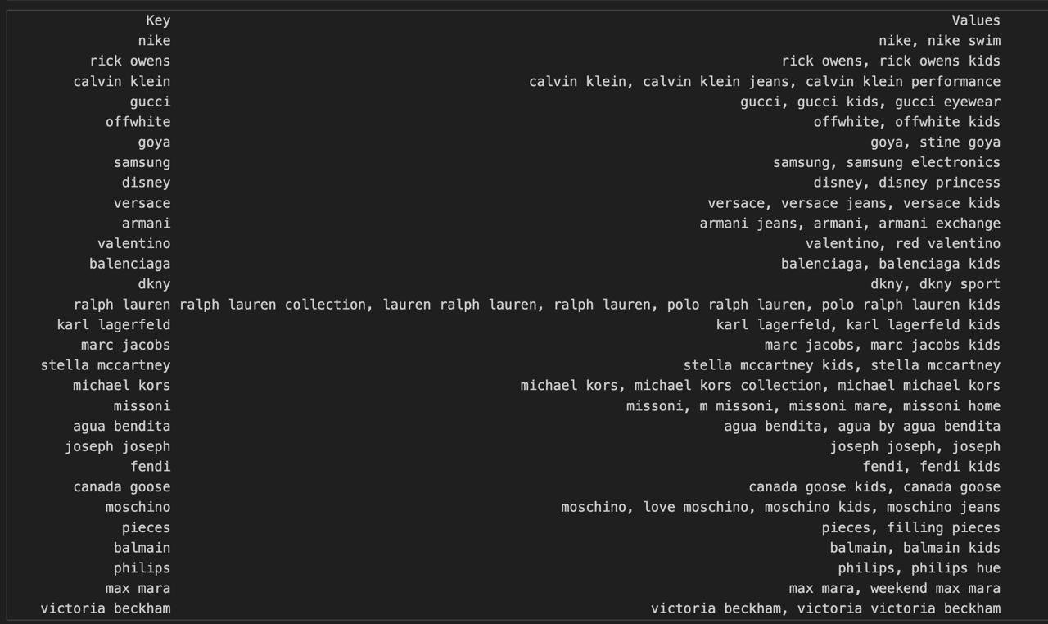
Similarity Calculation
Cleaning
Detailed Code Analysis
Steps Executed in Code:
Tokenize both brand names into sets.
Calculate the union and intersection of these sets.
Assign weights and compute weighted intersection and union.
Final similarity score calculation as a percentage.
Technical Approach
Scrapping and API

Slide 14
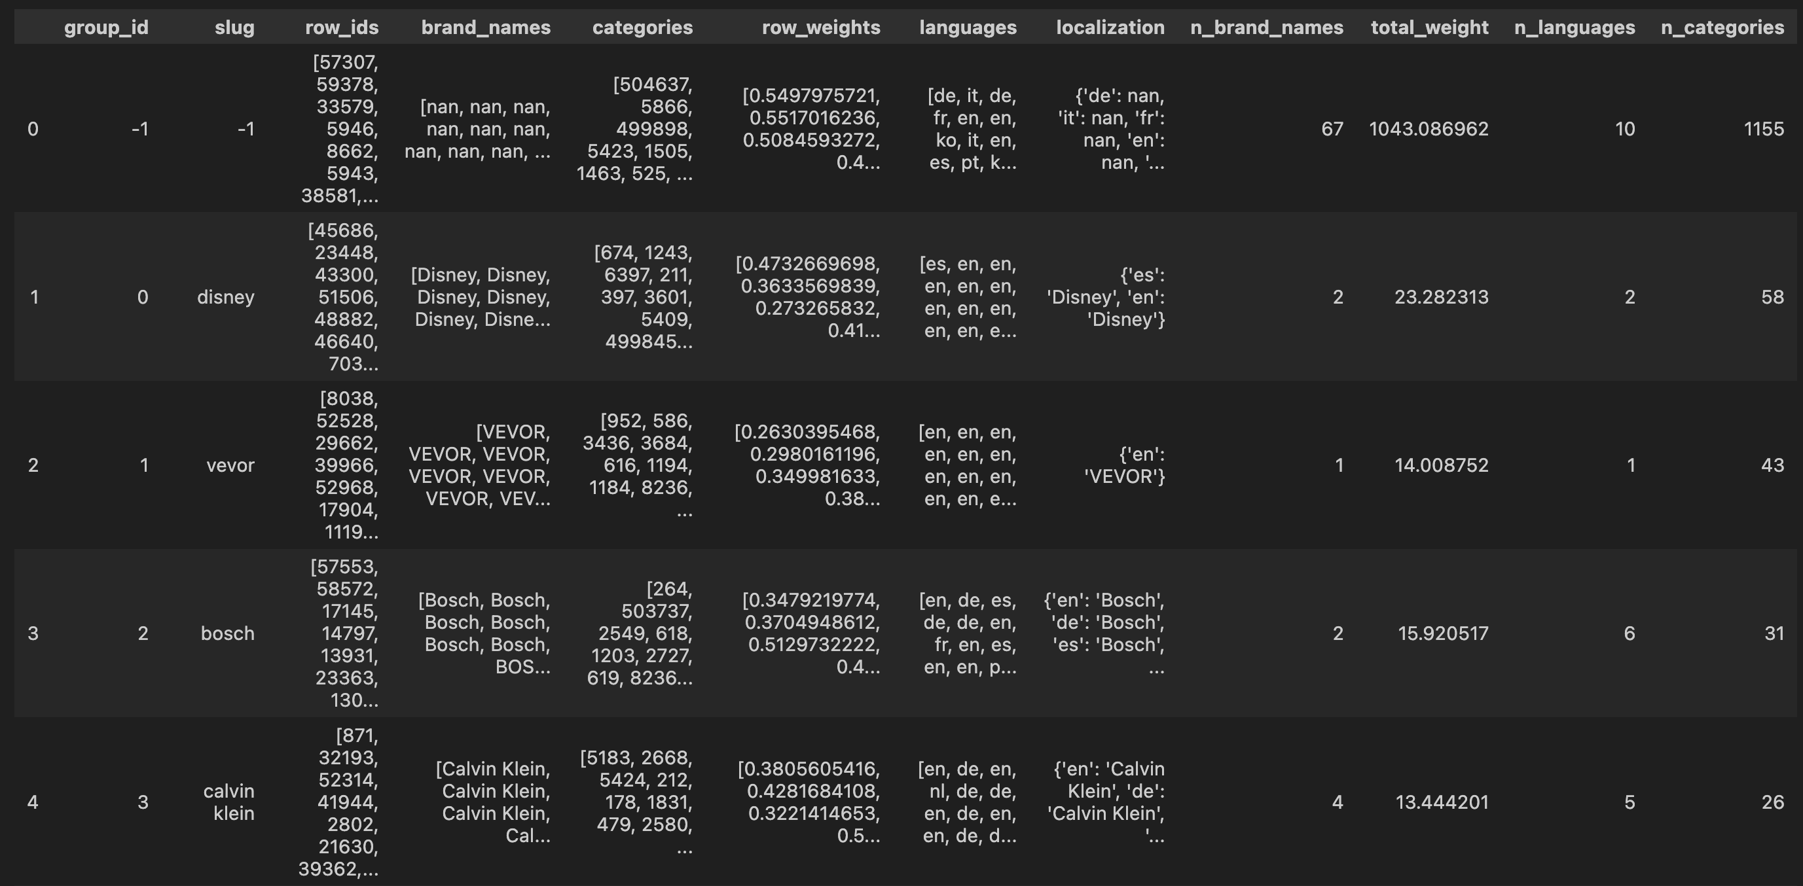
Similarity Calculation
Cleaning
Computing Pairwise Weighted Similarity
Technical Approach
Scrapping and API

Slide 15
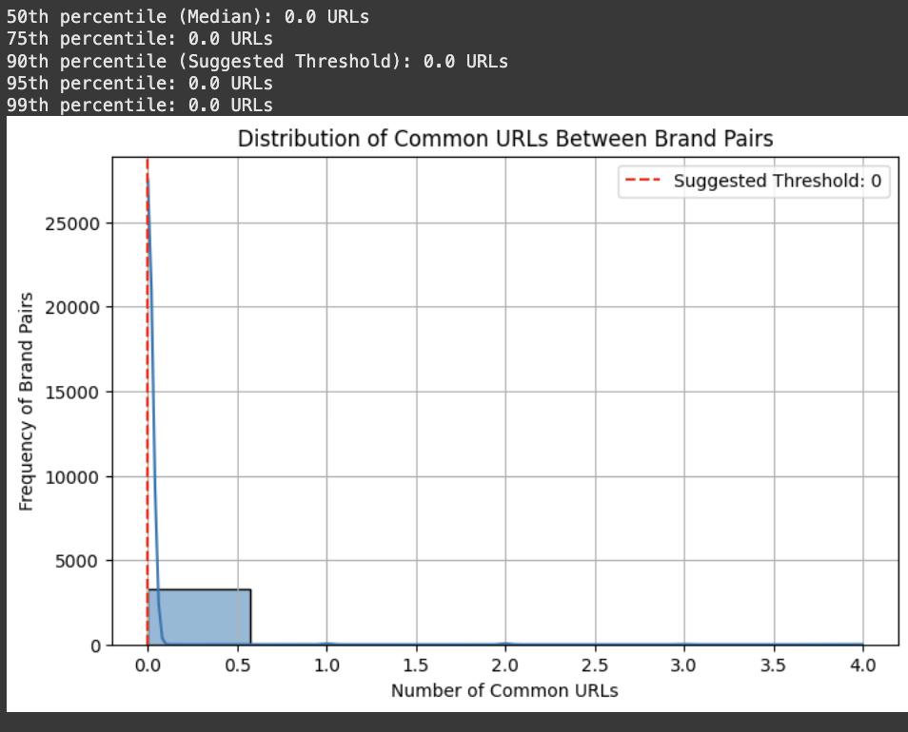
Similarity/Fuzzy Matching
Cleaning
Technical Approach
Scrapping and API
4 layers of added variables:
3 by using a google search engine API and scraping URLs from specific search terms in the bar search ("brand name", "brand name + logo"…)
1 by using Gemini API and prompting to get descriptions for given brand names

Slide 16
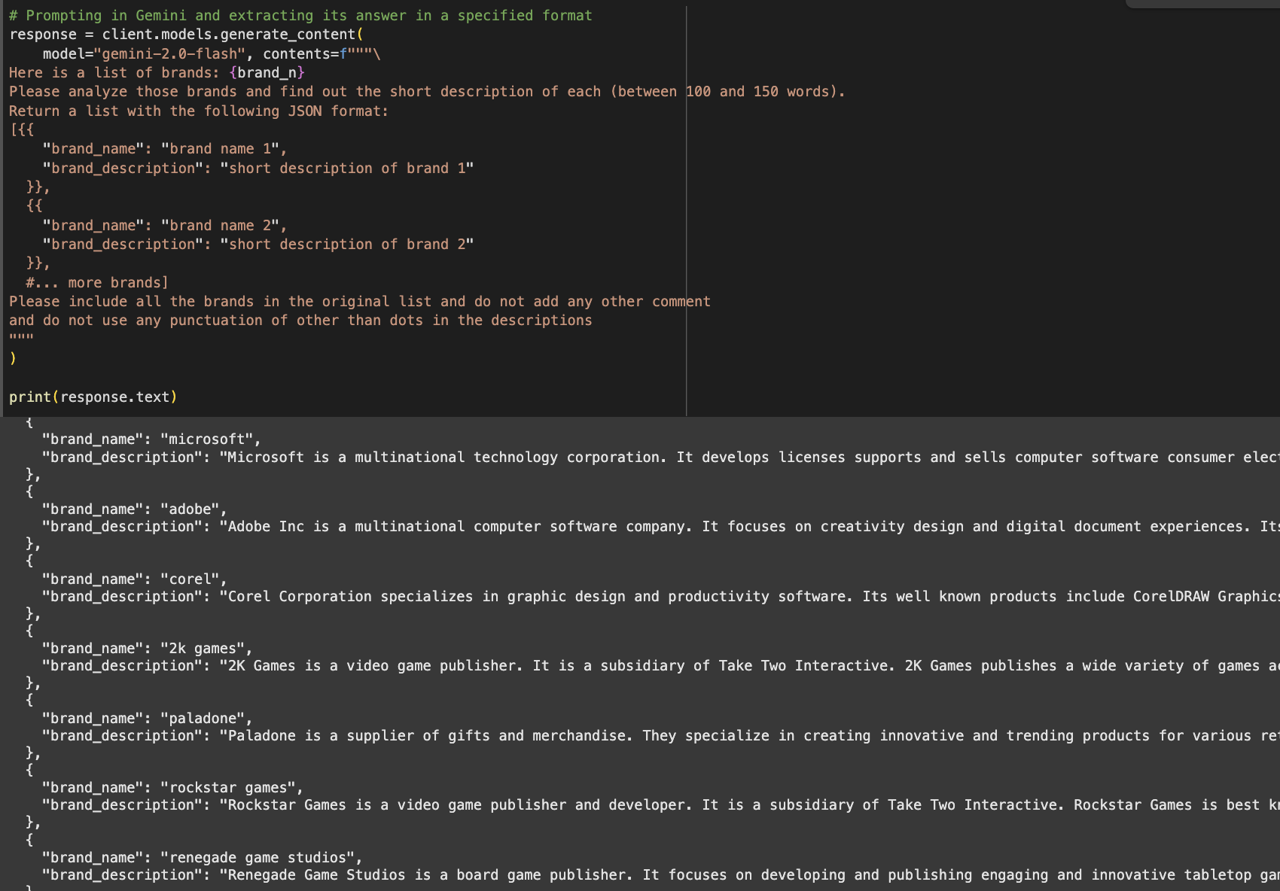
Similarity/Fuzzy Matching
Cleaning
Technical Approach
Scrapping and API
Then adding data to the dataframe and analyzing the similarity between these added variables and grouping brands when the similarity is above a chosen threshold

Slide 17
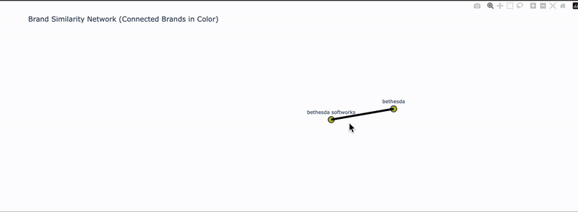
Analysis and Visualization: Bringing Brands Together
Similarity grouping with added data

Slide 18
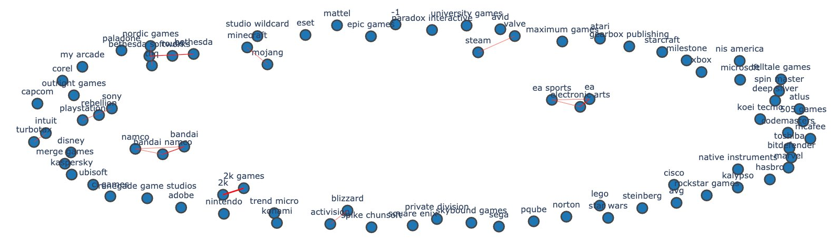
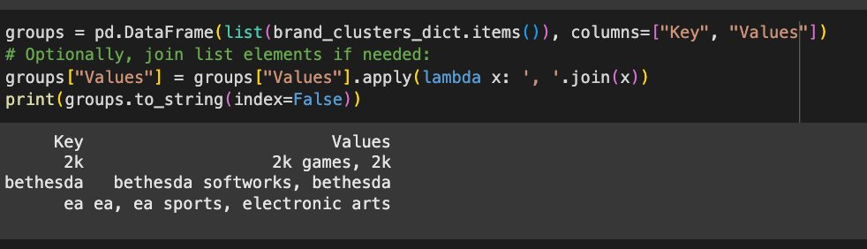
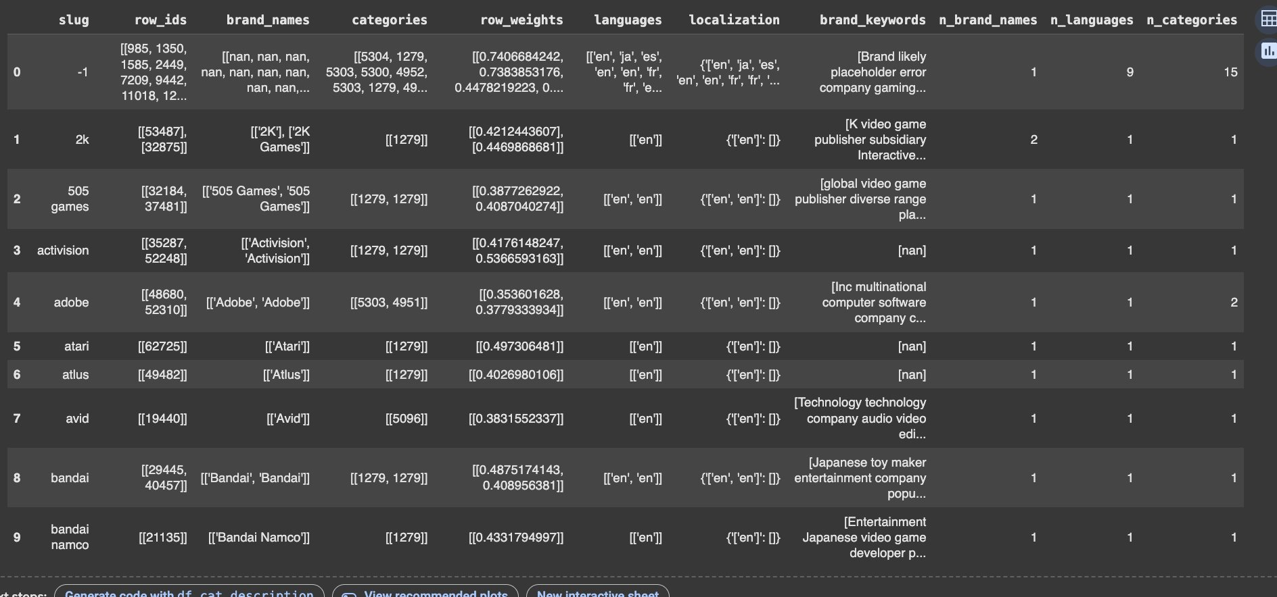
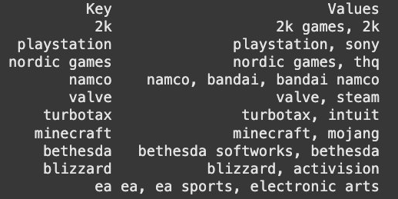
For the 3 layers of added URLs, a brand pairwise count of common URL is computed and the brands are added to same group if the count is above selected threshold
Analysis and Visualization: Bringing Brands Together
Similarity grouping with added data

Slide 19
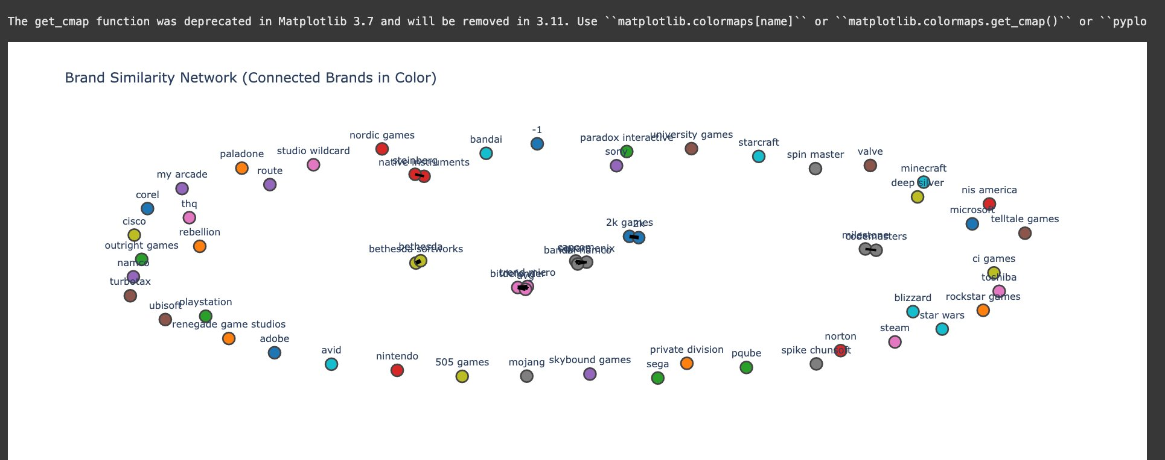
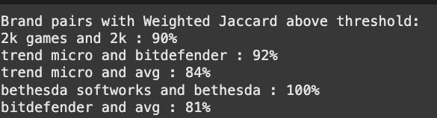
For the added Description, a cleaning is performed to keep only keyword and compute the brand pairwise similarity of their associated keywords vectors
the brands are then added to same group if the similarity is above selected threshold
Analysis and Visualization: Bringing Brands Together
Similarity grouping with added data

Slide 20
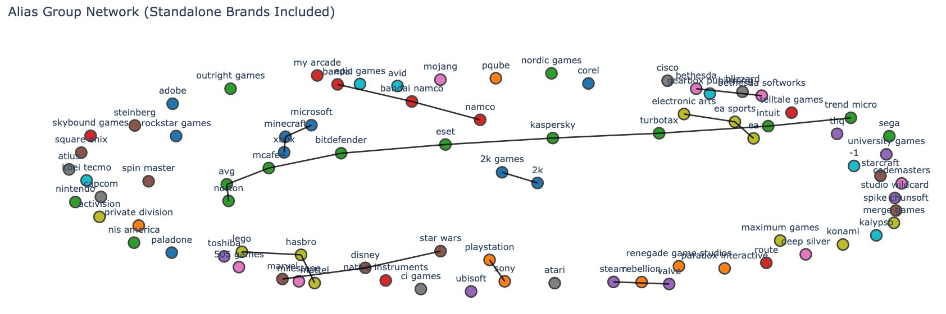
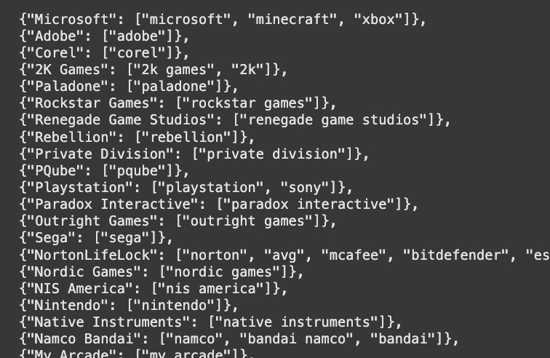
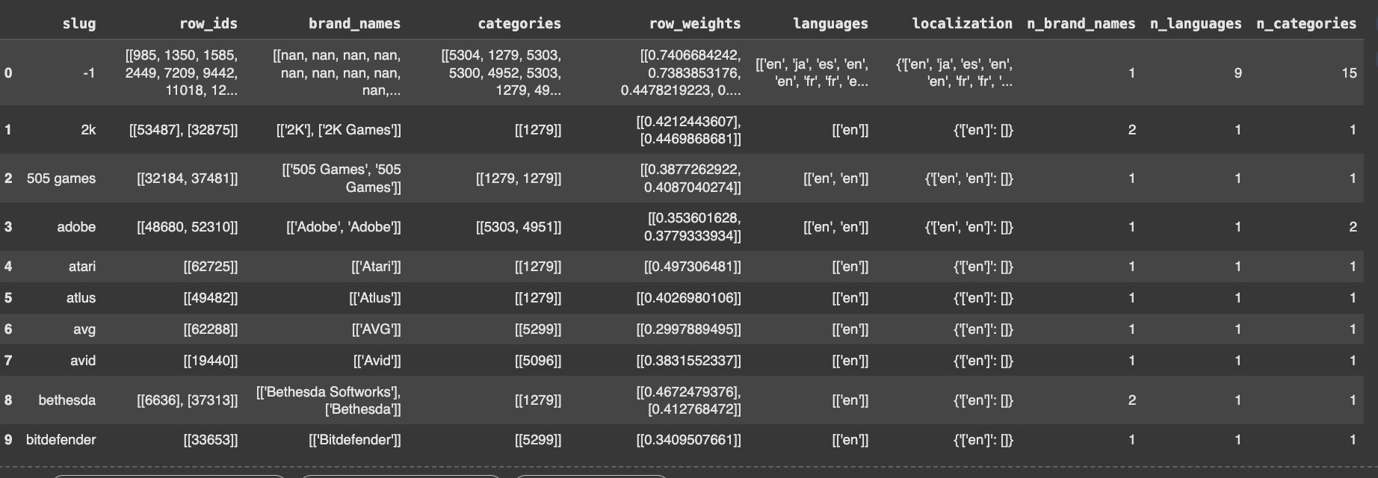
To evaluate the performance of the different methods, we compared the groups made after analyzing for similarity and the groups made by Gemini when prompted to group the brands together based on his knowledge. We get the following output
Evaluation metric's result

Slide 21
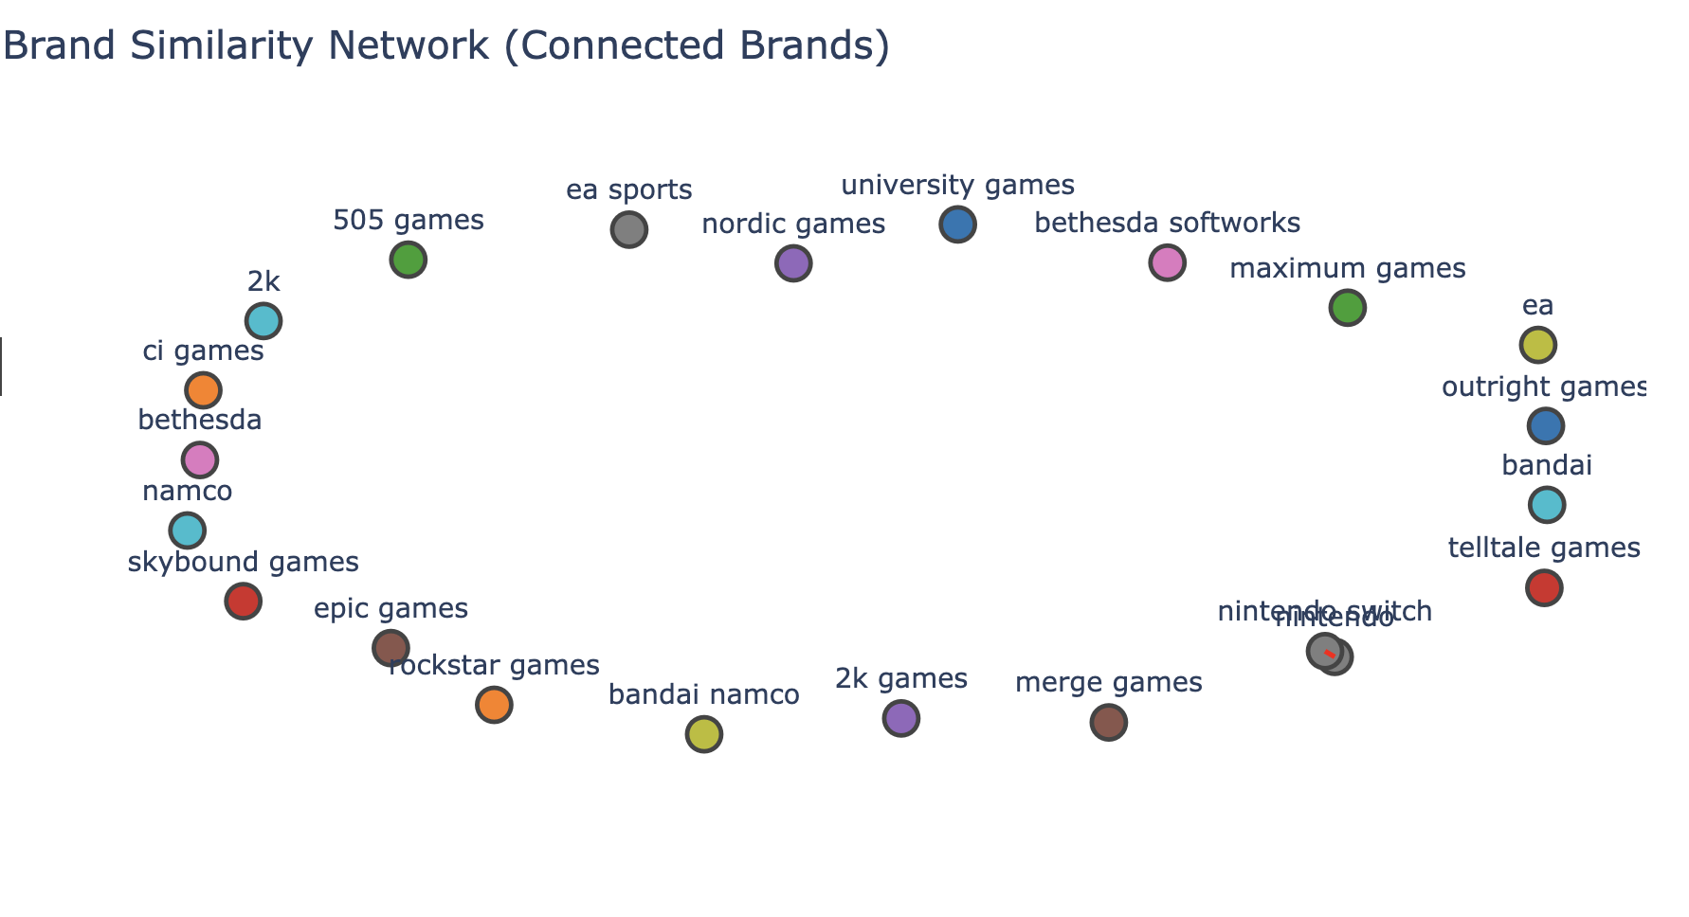
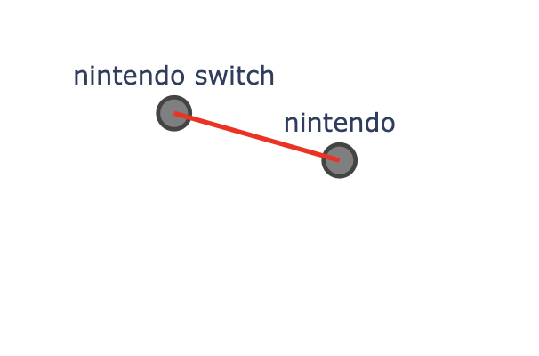
Evaluation metric's result

Slide 22
Use Cases
RETAIL MEDIA and UNIFICATION OF DATA
CASE
SOLUTION
EXAMPLES AND IMPACTS
Implement real-time pricing strategies using unified data
Users see consistent prices across platforms, increasing trust and likelihood to buy.
Dynamic Pricing Campaigns
Inventory-Driven Advertising
Adjust ad placements based on real-time stock levels
Prevent ad spend on out-of-stock items, enhancing ROI and customer satisfaction.
Seasonal Promotion Optimization
Harmonize seasonal campaigns across multiple retailers
Coordinated ads boost visibility and sales during peak seasons.
Enhanced Customer Segmentation
Improve accuracy in customer targeting with cleaner data
Targeted ads based on accurate user profiles increase conversion rates.
Compliance-Driven Targeting
Ensure regional compliance through consistent data use
Unified branding helps adhere to advertising standards, reducing legal risks

Slide 23


BUSINESS IMPACT
Enhanced Customer Experience
Sustainability in Advertising
Consistency across all platforms increases brand loyalty and customer satisfaction.
Seamless interactions elevate user experience, driving repeat business
Reduced digital waste through targeted advertising reduces carbon footprint.
Alignment with consumer values around sustainability enhances brand reputation.
Operational Efficiency
Streamlined operations reduce costs and improve speed to market.
Data centralization simplifies management and enhances productivity.
Innovative Advertising Solutions
Advanced personalization capabilities from accurate data analysis.
Development of cutting-edge ad technologies that resonate with target demographics.
Data-Driven Decision Making
Enhanced Compliance and Reduced Risk
Access to cleaner, consolidated data enables precise analytics.
Real-time insights allow for dynamic marketing and optimized ad spend.
Unified data helps meet diverse regional compliance requirements.
Minimized legal risks through adherence to international privacy laws.

Slide 24
Thank you!
We are Group 17

